Slide 1
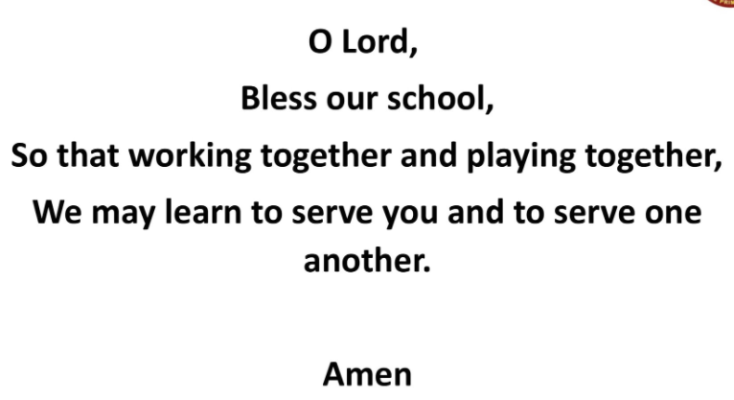


GATHER
Tuesday
7th September
Feast of
Saint Teresa of
Calcutta
Today we learn that Jesus didn’t care for external show or mindlessly following rules.
He taught that true holiness comes from the inside out. We are encouraged to make
love the guiding rule in our lives!

Slide 2
Each class has chaplains to help us to:
Live, Love and Learn Together
Growing with God, in Knowledge and Faith.
Each class has their own saint, when we celebrate their Feast Day.
We also celebrate the Feasts of other Saints throughout the year.
GATHER
Tuesday
7th September
Feast of
Saint Teresa of
Calcutta

Slide 3
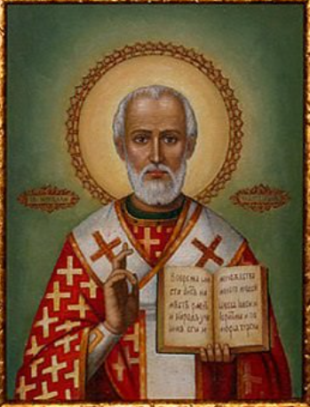
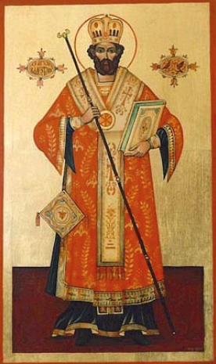
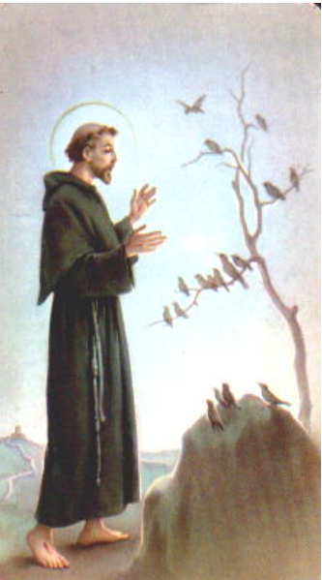
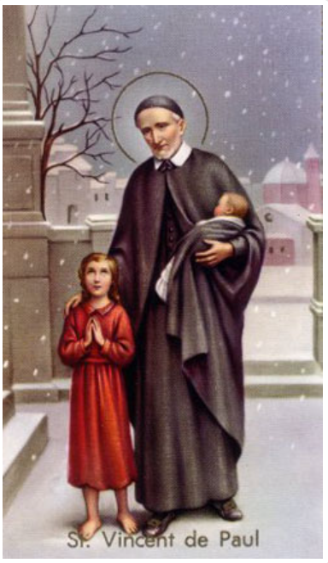
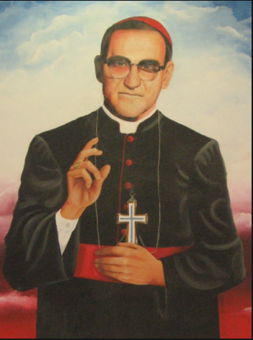
Oak St. Nicholas
Sycamore St. Valentine
Ash St. Francis of Assisi
Hazel St. Vincent de Paul
Maple St. Oscar Romero
GATHER
Tuesday
7th September
Feast of
Saint Teresa of
Calcutta

Slide 4
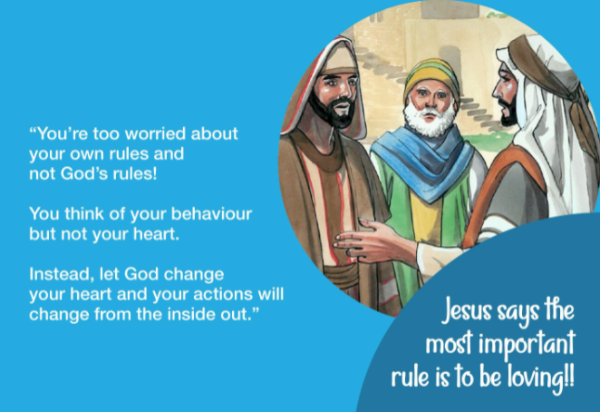

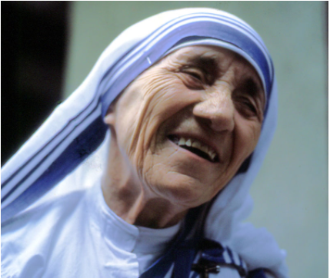
LISTEN
Tuesday
7th September
Feast of
Saint Teresa of
Calcutta

Slide 5
Last Sunday was the Feast Day of Saint Teresa of Calcutta.
Five years ago, Mother Teresa was canonized, this means she became a saint.
Forty – five years ago she was awarded the Nobel Peace Prize after dedicating her life to others.
Saint Teresa is one such person who shone from the inside out.
LISTEN
Tuesday
7th September
Feast of
Saint Teresa of
Calcutta

Slide 6
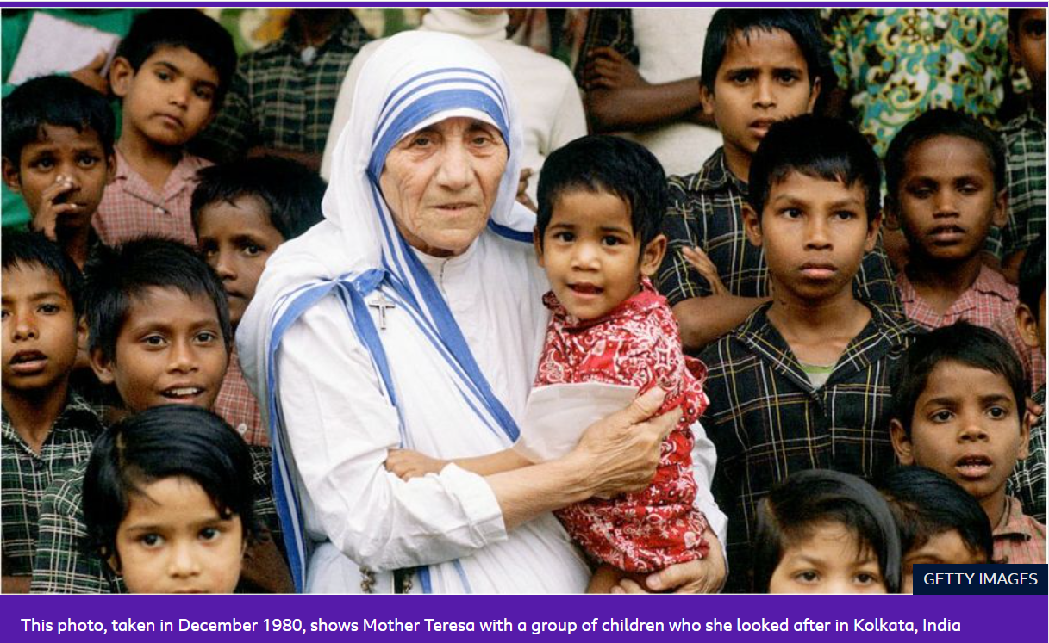

Slide 7
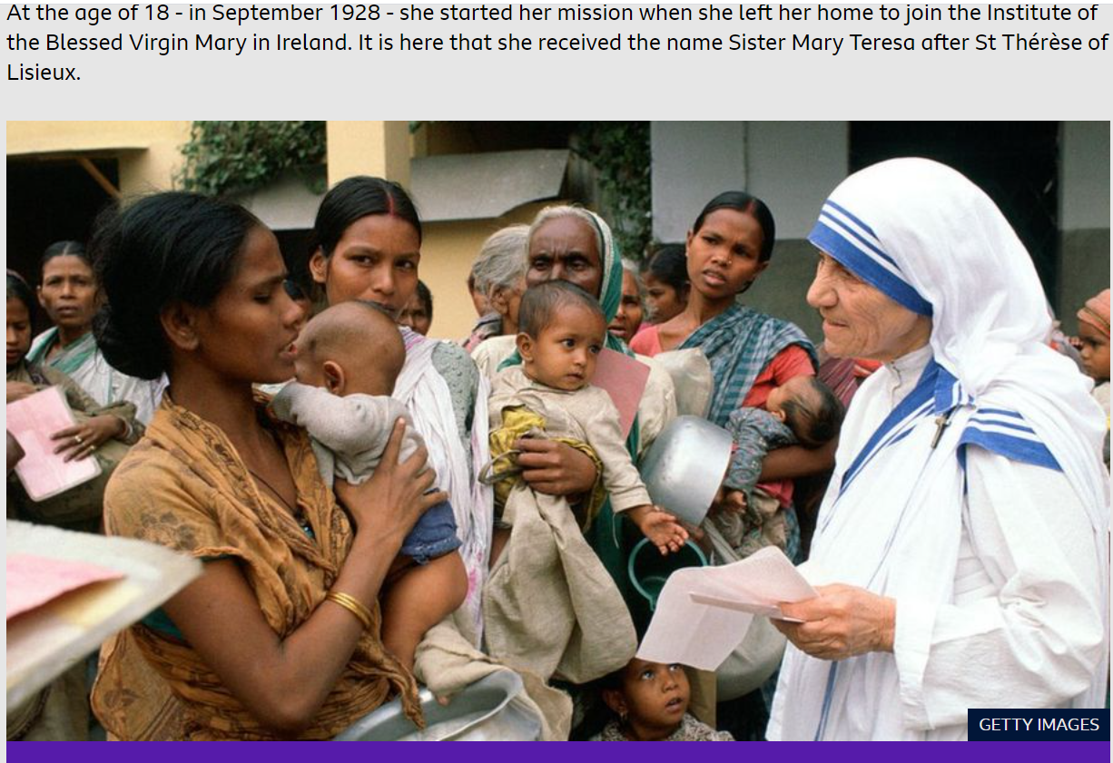

Slide 8
In December, she left Ireland to travel to India, arriving in Kolkata on 6 January 1929 to teach in a girls' school.
From 1937, she became known as Mother Teresa, but it was a train ride on 10 September 1946 which would change her life forever.
It is on this journey that Mother Teresa said she received her "inspiration" to carry out what she described as the work of God, devoting herself to helping people who lived in the slums of Kolkata.
On 17 August 1948, she stepped out for the first time in her white and blue sari, for which she is now so well known.
LISTEN
Tuesday
7th September
Feast of
Saint Teresa of
Calcutta

Slide 9
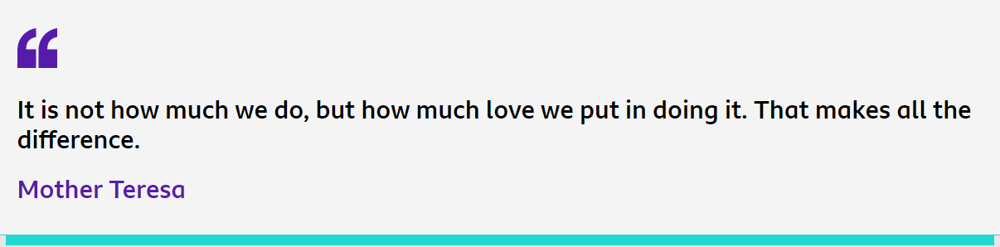
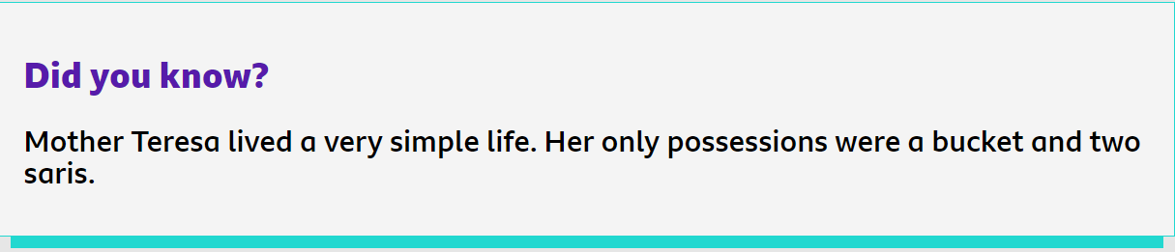

Slide 10
In 1950, she founded an organisation called the Missionaries of Charity, which was a sisterhood dedicated to helping the poor.
It expanded internationally and to this day has around 4,500 nuns and 400 brothers across 87 countries, all of whom look after the poor and the sick in the slums of around 160 cities across the world.
Her charitable efforts have been widely celebrated and recognised all over the planet. She was invited to speak at both the United Nations General Assembly and the Vatican.
LISTEN
Tuesday
7th September
Feast of
Saint Teresa of
Calcutta

Slide 11
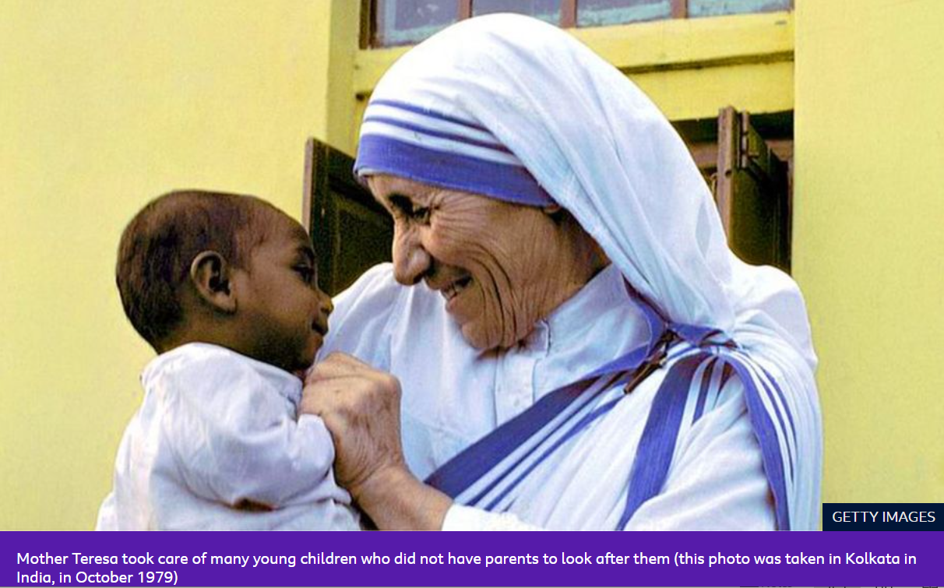

Slide 12
Mother Teresa has won a string of awards for her charity work - the most notable being the Nobel Peace Prize, which she was given in 1979.
Upon receiving the prize, she said she was "happy to receive it in the name of the hungry, the naked and the homeless."
She asked for a big dinner organised to mark her winning the award to be cancelled, and for all of the money to be given to the poor people of Kolkata instead.
LISTEN
Tuesday
7th September
Feast of
Saint Teresa of
Calcutta

Slide 13
Mother Teresa died on 5 September 1997 at the age of 87, and was given a state funeral in India.
While she had some controversial opinions which some people disagreed with, Mother Teresa is remembered as an incredibly selfless person who wanted to help those less fortunate than herself.
Some years later, in 2016, Pope Francis recognised Mother Teresa as a saint.
LISTEN
Tuesday
7th September
Feast of
Saint Teresa of
Calcutta

Slide 14


RESPOND
Tuesday
7th September
Feast of
Saint Teresa of
Calcutta

Slide 15
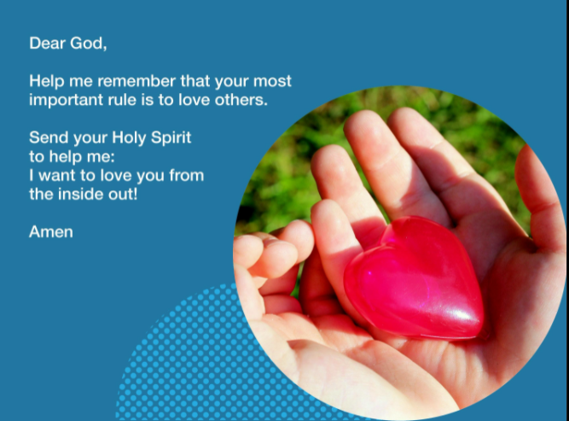
RESPOND
Tuesday
7th September
Feast of
Saint Teresa of
Calcutta

Slide 16


As we think about how we can shine our light from
Inside Out
Let’s listen to
Love so Great
By Hillsong Worship
Click on the heart to play………..
GOING
FORTH
Tuesday
7th September
Feast of
Saint Teresa of
Calcutta

