Slide 1
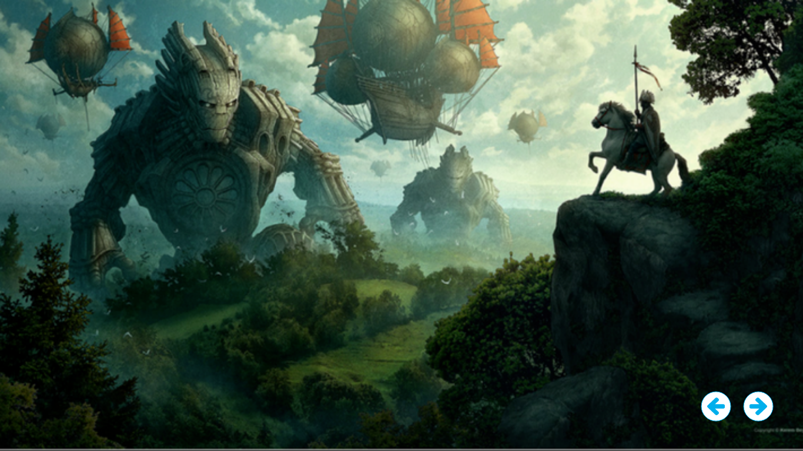
The Invasion

Slide 2
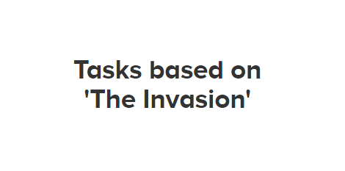

Slide 4
Sentence challenge - write in your Home Learning Book
These sentences are ‘sick’ and need help to get better. Please help.
The big scary giants were walking. They had massive, big hands and their eyes were shining.
avoid repetition
choose more powerful verbs
find more sophisticated adjectives
add some information to the beginning or end of the sentence

Slide 5
Grammar/Punctuation challenge - write in your Home Learning Book
Good writers always try to start sentences in different and interesting ways. Can you write a sentence that begins with a noun?
For example:
The warrior, who was nervous at the site that greeted him, gripped his spear tightly.
A comma always follows the noun, and the sentence contains a relative clause in the middle.
The warrior, ______________________. _________________
The horse, ___________________, ___________________
A robot, ________________________, _______________

Slide 6
Story Starter
Many years ago, when I was just a small boy, we found a mysterious object washed up on the beach. It was a sort of silver-grey colour, and looked like a finger, only much, much larger.
My friends and I had huddled together on the beach around the thing, holding our hands up to our faces to shield our eyes from the dazzling sun, talking excitedly about what it could be. Some hours later, after we had all made up wild stories about the origin of our new toy, we dragged the colossal item that was the size of our dining table up to the village.
Over the next days, weeks, months and years, stories were told of how our land was in danger from some kind of threat. There was fretful talk of giants, and frantic warnings about unearthly automatons come to take our lands from us. For years, people had looked over their shoulders, fearful that they were being watched, fearful that something unexpected and terrible was about to occur. For years, unsatisfied farmers had complained about their disappointing harvests, prophesising that the end of the world was near!
Of course, none of us believed them, and none of us thought anything as sinister as the end of the world was just around the corner. But, we did seem to know in our heart of hearts that something was amiss. Something wasn’t quite right…
15 Years later…
Continue the story.

Slide 7
Continue the story – Home Learning Books. Thinking about these questions will help you. Make notes first if it helps.
Who/what are these things that are approaching?
Are the people right to be wary?
Do you think the new arrivals mean harm or do they come in peace?
How many of them do you think they are?
Where have they come from?
Who is the character telling the story?
How will people deal with this ‘threat’?
Who controls the airships, the invaders or the defenders?

Slide 8
Picture it!
Design your own giant robot.
It could be friendly/helpful, or it could be evil and wicked!

Slide 9
Thank you
Photo courtesy of Kerem Beyit.
www.behance.net/kerembeyit

