Slide 2
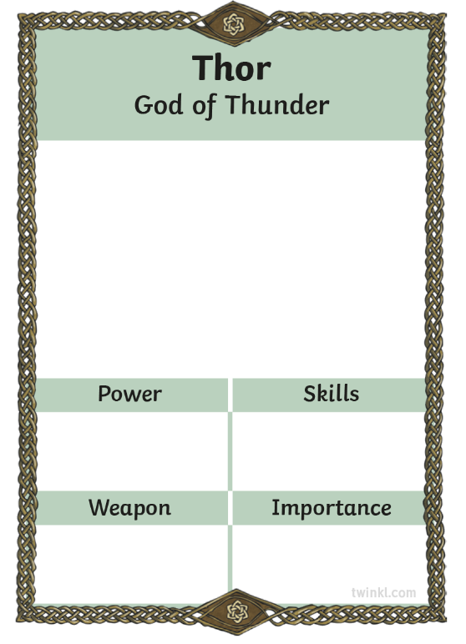
Viking Gods
First, take a card and find out which god or goddess you have.
Here is a card for Thor – God of Thunder.
The next thing you need to do is find out some information about your god or goddess.

Slide 3
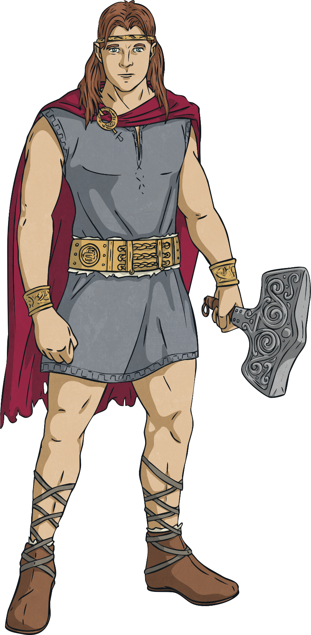
Thor
Thor is the god of thunder, storms, strength and fertility. He is part of the Æsir pantheon. He is the son of Odin and married to the goddess Sif.
. He is the son of Odin and married to the goddess Sif.
Thor wields a magical hammer called Mjolnir which is so powerful it can destroy mountains. He is able to summon thunder and lightning using his hammer in battle against his enemies. Vikings believed that a thunderstorm was a sign that Thor was angry.
Thor also has incredible strength and is a mighty warrior. There are many tales of his battles, including with the giant serpent Jörmungandr during Ragnarök – the final battle of the gods.

Slide 4
Viking Gods
When you have your information, you need to use it to fill in the scores.
Give each category a mark out of 10.
How powerful is Thor?
Does he have a special skill?
Does he have a weapon?
How important is he?

Slide 5
Viking Gods
When you have filled in the scores, draw a picture of your god or goddess.
Don’t forget to include any weapons or other items they might be carrying and anything else relevant to them.

Slide 6
Viking Gods Card Game
When all the cards are finished you are ready to play the game!
Share the cards between all players.
Players must keep their pile of cards in the same order.
Each player looks at one card at a time.
The first player chooses the category they think their card is strongest on and reads it out.
All players share the score on their card for that category.
The player with the highest score wins all the cards used that round and puts them at the bottom of their pile. It is that player’s turn to pick the next category.
If more than one card has the same top value, the cards are placed in the middle until someone wins a round and the same person reads out another category.

