Slide 1
This interactive PowerPoint tells the story of the ‘Less Than Monkey,’ who is stealing animals from the zoo. Ask your child to tell you what is one less than the total to see how many animals are left.
This PowerPoint is an engaging way of encouraging your child to practise the skill of taking one away from a given number, the first steps of subtraction. It also includes a number line as a visual aid.
Count objects in real life, such as birds in a tree or cars on the road. Ask your child what one more or one less than the total would be. Do the same with price tags in a shop or books on a shelf.

Slide 3
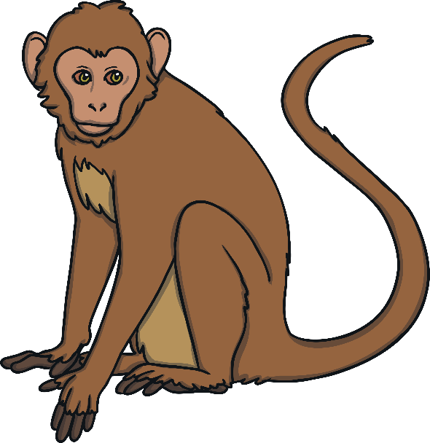
Every time the zookeeper arrives at an animal enclosure and counts the animals, the ‘less than’ monkey removes one. Can you help the zookeeper work out what one less will be?
Today, the zookeeper is trying to count the animals in each enclosure but the cheeky ‘less than’ monkey is there.

Slide 4
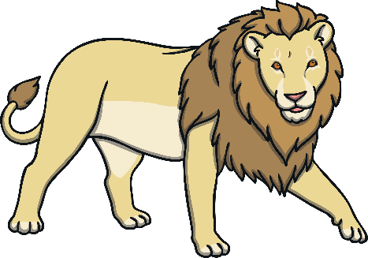
How many lions are there?
Oh no! The ‘less than’ monkey is going to take one away. What is one less than 3?
0
1
2
3
4
5
6
7
8
9
10
One less than 3 is 2.

Slide 5
How many elephants are there?
Oh no! The ‘less than’ monkey is going to take one away. What is one less than 5?
0
1
2
3
4
5
6
7
8
9
10
One less than 5 is 4.

Slide 6
How many frogs are there?
Oh no! The ‘less than’ monkey is going to take one away. What is one less than 8?
0
1
2
3
4
5
6
7
8
9
10
One less than 8 is 7.

Slide 7
How many snakes are there?
Oh no! The ‘less than’ monkey is going to take one away. What is one less than 6?
0
1
2
3
4
5
6
7
8
9
10
One less than 6 is 5.

Slide 8
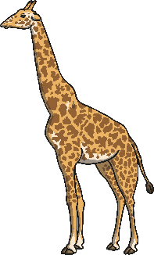
How many giraffes are there?
Oh no! The ‘less than’ monkey is going to take one away. What is one less than 4?
0
1
2
3
4
5
6
7
8
9
10
One less than 4 is 3.

Slide 9
How many birds are there?
Oh no! The ‘less than’ monkey is going to take one away. What is one less than 10?
0
1
2
3
4
5
6
7
8
9
10
One less than 10 is 9.

