Slide 1
Welcome to Sycamore

Slide 2
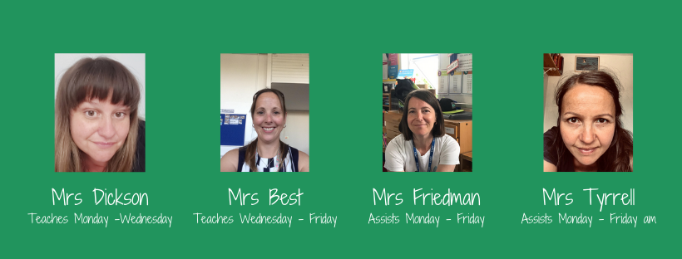
Sycamore’s Team

Slide 3
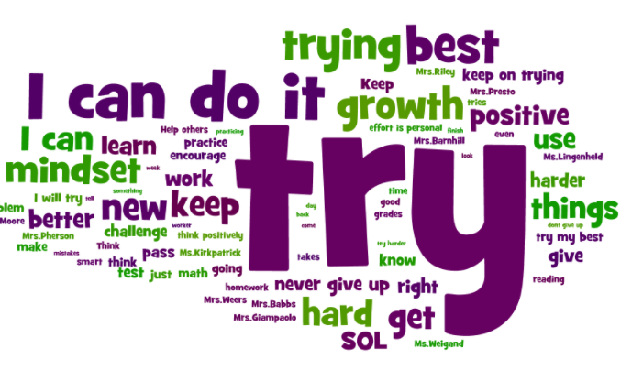
Being in Year 2
Independent and Responsible
Respectful
Resilient

Slide 4
Working together for your child
‘The education of the child is a partnership between home and school.’
gdickson@stcatherinesbridport.dorset.sch.uk
cbest@stcatherinesbridport.dorset.sch.uk

Slide 5
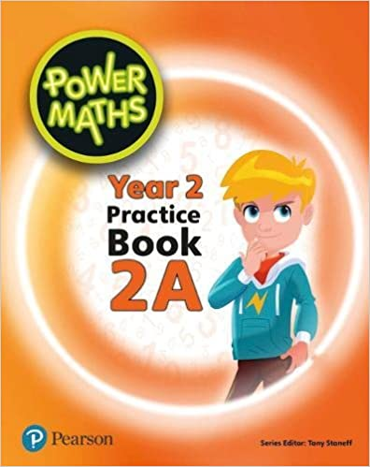
Maths
Last year St Catherine’s introduced a new programme of work called Power Maths.
Power Maths adopts a Maths Mastery approach. This approach enables children to challenge themselves and deepen their mathematical thinking during every lesson.
Children have the opportunity to develop their skills with their fellow class members through discussion and problem solving together. They then practice and apply their skills in their
textbook.

Slide 6
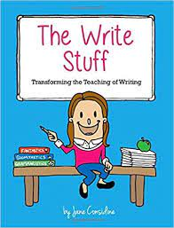
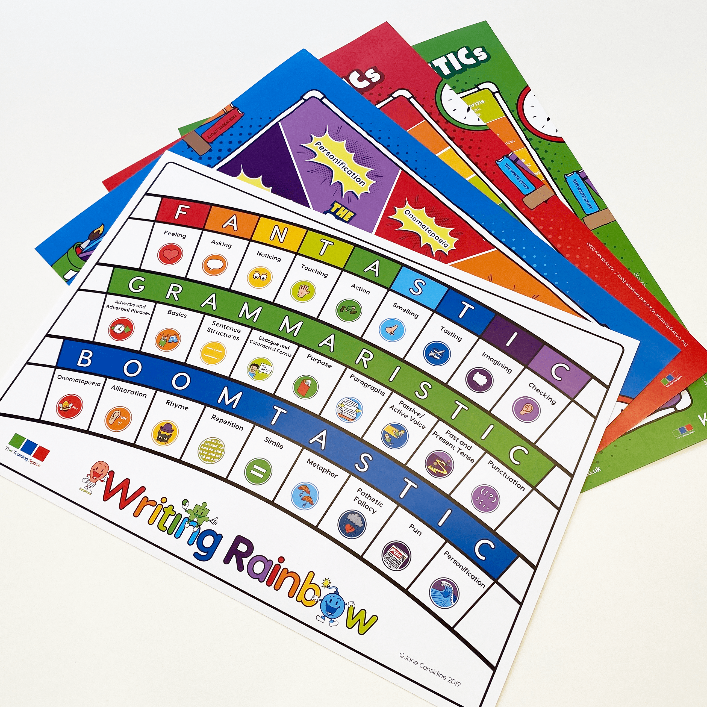
English
This year we are also really excited to introduce a new way of working in English. We will be following ‘The Write Stuff’ approach by Jane Considine.
Within this approach, children are taught through experience lessons and sentence writing lessons. Experience lessons support the children to gain a rich vocabulary bank related to a text or theme, which then supports their sentence writing.
The writing rainbow seen in the picture shows the three zones of writing within the approach….

Slide 7
English
The FANTASTICS
Nine ideas for writing - a way for us to gather language e.g dialogue / thought / feeling / imagining.
The GRAMMARISTICS
Nine lenses for writing - the tools for writing / grammar e.g punctuation / purpose.
The BOOMTASTICS
Nine techniques for writing - literacy devices e.g rhyme / alliteration.

Slide 8
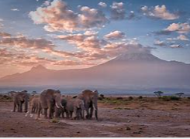
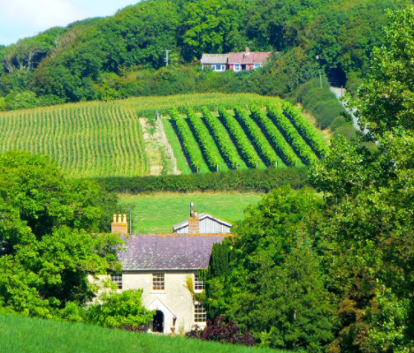
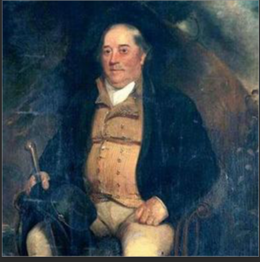
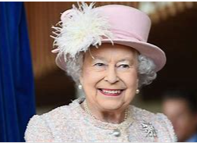
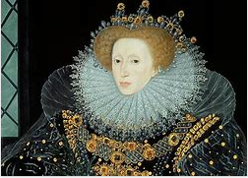
Topics

Slide 9
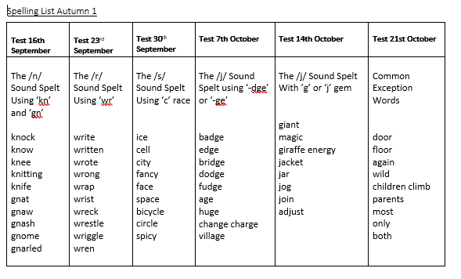
IXL – 2 Maths and 2 English tasks set on a Thursday to be completed by the following Wednesday.
Reading – Ditty book linked to phonics.
Children will keep their Ditty
book for a week – please
look at the activities and
questions at the back of
these books.
Lighthouse
Spelling – New spelling rule introduced on a Thursday

Slide 10
Website – General class information
- Knowledge Organisers
- Curriculum Objectives
- Curriculum Map
Rewards (Dojos and house points)
P.E will be on Tuesdays and Thursdays
Transition to KS2

Slide 11
At the end of Key Stage One, children will take part in Statutory Assessments in Reading, Maths, Spelling and Grammar.
The results of these assessments will inform the overall teacher judgements made at the end of the year.
Reading – Children will sit two papers. Paper one contains small sections of text and questions (30 mins approximately). Paper two contains a separate reading and question paper and children are expected to read longer texts (40 mins approximately).
Maths – Children will sit an Arithmetic Paper (20 mins approximately). and a Reasoning Paper ( 35 mins approximately).

Slide 12
Spelling and Grammar (optional) – Paper One is a 20 word spelling test.
Paper Two – Grammar and Punctuation (20 mins approximately).
Writing – children’s independent writing will be assessed by class teachers throughout the academic year and a final overall teacher judgment will be made at the end.

Slide 13
Please be reassured that we will be supporting children throughout the year in preparation for the assessments. Children will have the opportunity to sit practice papers, in order for them to feel more comfortable with test conditions.
We find it is helpful to call the assessments challenges rather than tests!
We will keep you regularly updated on how your child is progressing towards the end of key stage standards for Year 2. Please do ask if you have any further questions regarding this.

Slide 14
We look forward to a happy, productive year

