Slide 2
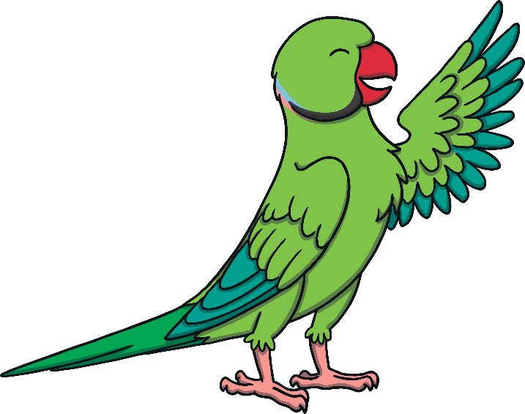
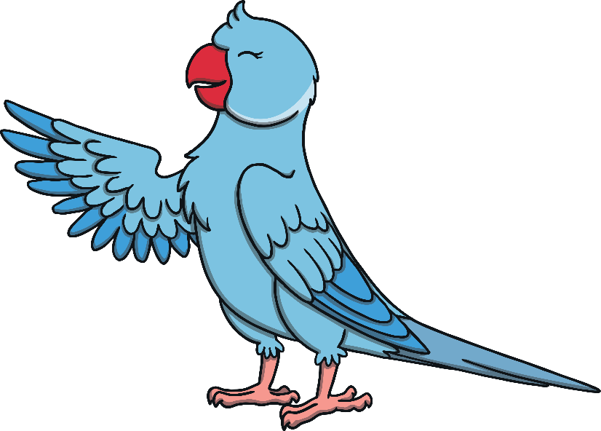
Penny and Jenny are good friends. They collect fruit together.
They like to be fair and take half of the fruit each.

Slide 3
They have collected 4 apples. How can they find half of 4?
Click here to halve the fruit!
There are two halves. Jenny and Penny each have one half.

Slide 4
They have collected 6 pears. Can we share 6 pears into two halves?
Click here to halve the fruit!
What do you notice about the halves?

Slide 5
They have collected 2 peaches. They each want half. What is half of 2?
Click here to halve the fruit!
How many peaches does Penny get? How about Jenny?

Slide 6
They have collected 8 bananas. How can we halve 8?
Click here to halve the fruit!
Do the parrots have the same number of bananas,
or a different number?

Slide 7
Penny and Jenny have half each. They each have 5. They have decided to put them back into one whole group and give them to Sidney Snake. How many oranges will Sidney get?
Click here to move the fruit back to one ‘whole’ group.
When we put the two halves together, we get the ‘whole’.

